Slide 1
RESEARCH ETHICS Orientation Workshop for Incoming PhD Students in Business Administration by Dr. Brian Detlor September 2024
The Campaign for McMaster University
The Campaign for McMaster University

Slide 2
About the Speaker
Dr. Brian Detlor
Professor (Information Systems)
McMaster Research Ethics Board (MREB):
Vice-Chair (July 2022 – June 2024)
Chair (July 2011 – June 2015)
Member (July 2003 – June 2006)
School of Business Student Research Ethics Committee (SBSREC):
Chair (Jan 2002 – June 2003)
Member (July 2000 – Dec 2001)

Slide 3
What We Will Talk About?
What is research ethics?
Why is it important?
What policies govern research ethics @ McMaster?
How is research ethics administered @ McMaster?
What types of research need ethics clearance?
What things do reviewers look for when reviewing an research ethics application?
What research ethics resources exist @ McMaster?
How does one submit a research ethics application @ McMaster?

Slide 4
Research Ethics
What is it?
Research is defined as “an undertaking intended to extend knowledge through a disciplined inquiry or systematic investigation” (Tri-Council Policy Statement: Ethical Conduct for Research Involving Humans)
Research ethics pertains to the ethics around the planning, conduct, and reporting of research. The main objective is to protect human participants by examining specific research activities such as the management of risk, the protection of confidentiality, and the process of free and informed consent

Slide 5
Research Ethics
Why is it important?
To ensure good ethical research practice is followed
To be in compliance with the Tri-Council Policy Statement on the Ethical Conduct for Research Involving Humans (TCPS2)
All research at McMaster (e.g., by students, faculty, staff, research in the classroom) involving human participants and/or their personal records, whether or not funded by one of the Tri-Councils, must adhere to the TCPS 2
The Tri-Councils audits McMaster annually for compliance
If in violation, research funding to the university could be withheld!

Slide 6
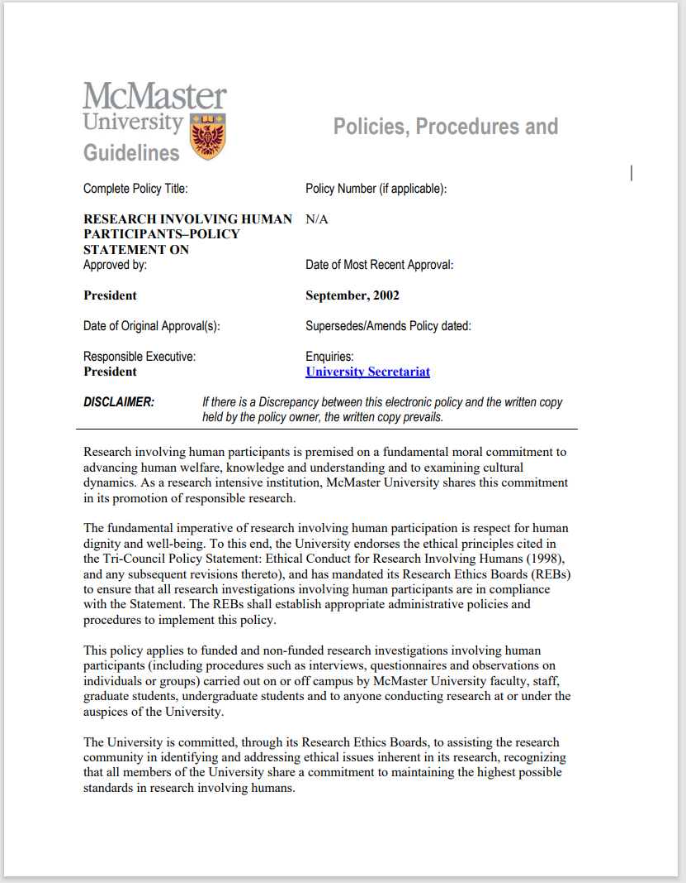
Policies & Guidelines
McMaster’s: “Research Involving Human Participants” (2002)

Slide 7
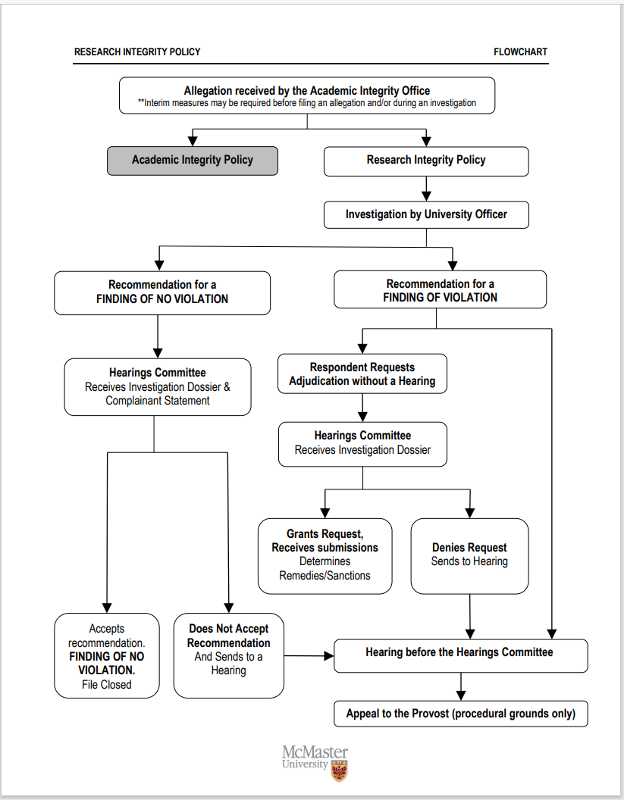
Policies & Guidelines
McMaster’s: “Research Integrity Policy” (2017)

Slide 8
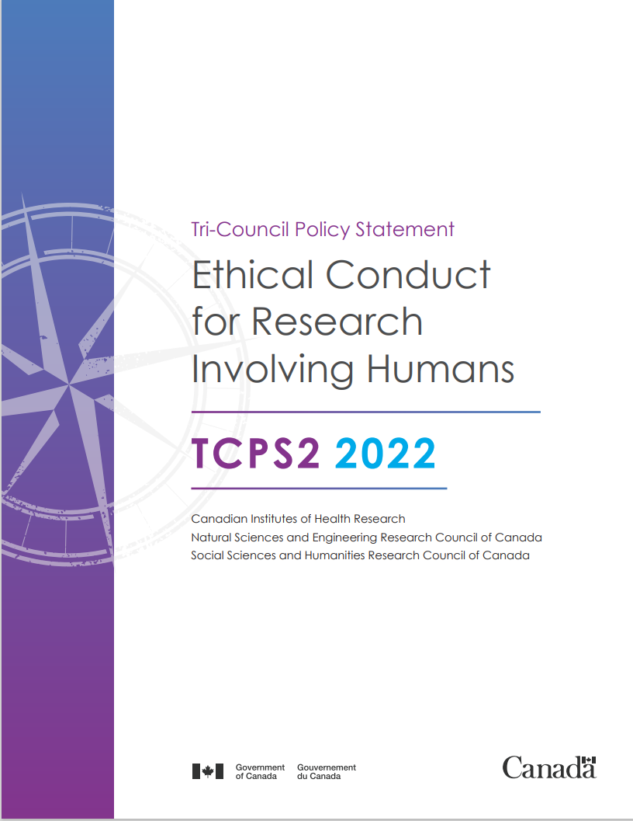
Policies & Guidelines
Canada’s: “Tri-Council Policy Statement – Ethical Conduct for Research Involving Humans” (TCPS 2nd ed. - 2022)

Slide 9
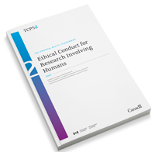
Policies & Guidelines
TCPS 2: CORE-2022 (Course on Research Ethics)
Consists of nine modules and a knowledge consolidation exercise
Each module ends with 4-5 quiz questions
The knowledge consolidation exercise consists of 25 randomly-selected multiple-choice questions from a question bank
To obtain a CORE-2022 Certificate of Completion, you will need to correctly respond to 20 questions (80%)
You can retake the knowledge consolidation exercise as many times as needed

Slide 10
Research Ethics Boards @ Mac
HiREB – Hamilton Integrated Research Ethics Board
Oversees research conducted by:
Faculty, staff or students in the Faculty of Health Sciences, Hamilton Health Sciences (HHS) or Saint Joseph Healthcare Hamilton
Other McMaster researchers utilizing HHS patients (including human biological materials) with their research.

Slide 11
Research Ethics Boards @ Mac
MREB - McMaster Research Ethics Board
Oversees all other research at Mac not reviewed by the HiREB conducted by faculty, staff or students
Is an arms-length body (autonomous entity) within the university
Adopts a “participant” and “proportionate” perspective towards research when reviewing research protocols

Slide 12
MREB Governance
Chair – Tara La Rose (Social Work)
Vice-Chairs – David Ogborn (Communications Studies & Media Arts) & Niko Yiannakoulias (Geography & Earth Sciences)
Administrative Support
Nick Caric (Assistant Director – Research Ethics)
Karen Henderson (Research Ethics Officer)
Lisungu Chieza (Research Ethics Advisor)
Nicole Gervais (Research Ethics Advisor)
Board Members
About 30 people comprising McMaster faculty, staff & community members

Slide 13
Types of Reviews Handled by MREB
Full review
Protocols with more than minimal risk, tricky protocols, or protocols which are good examples for the educational training of Board members
Reviewed by all members of the Board
Discussed at a monthly Board meeting
Researchers involved in the protocol often are invited to be present at the Board meeting where their protocol is discussed

Slide 14
Types of Reviews Handled by MREB
Delegated review
Most common type of review
Pertains to minimal risk research
Involves independent reviews by at least one Board Member, followed by a decision by the Chair
Delegated reviews can be referred to a full REB review (if warranted)
Decisions on delegated reviews must be well documented and formally reported to MREB in a timely & appropriate manner

Slide 15
Types of Reviews Handled by MREB
Executive review
Pertains to amendments to previously approved protocols and to protocols approved by REBs at other institutions
Involves a review and decision by the Chair
Executive reviews can be referred to a delegated review or a full review (if warranted)

Slide 16
SRECs
Student Research Ethics Committees
MREB delegates the review of course-based research, as well as thesis-based research by undergraduate students to SRECs
Anthropology/Religious Studies & Geography SREC
Business and Engineering SREC
Health Aging & Society SREC
Humanities SREC
Kinesiology SREC
Labour Studies SREC
Psychology SREC
Sociology SREC

Slide 17
What Requires MREB Review?
(Non-medical) research involving living human participants (and their personal records)
Pilot studies require MREB review
Note that validation of survey instruments, and initial discussions with organizations about conducting research, are not considered pilot studies (these activities do not require MREB review)

Slide 18
What Doesn’t Require MREB review?
The following research is exempt by TCPS 2:
Research that relies exclusively on publicly available information, the observation of people in public places, or the secondary use of anonymous information
Quality assurance/improvement studies, program evaluation activities, program reviews, testing within normal educational requirements used exclusively for assessment, management or improvement purposes
Creative practice activities (e.g., artist creations or interpretations of works of art)

Slide 19
Multi-Jurisdictional Review
Some organizations/communities have their own their Research Ethics Committees
e.g., Indigenous communities, school boards, correctional services Canada, hospital REBs
Research conducted outside Canada must meet any review requirements (REB or similar) at the research site
If no such review body exists, MREB practice is to recruit an arms- length ad hoc advisor with some knowledge of the local context, if necessary, to provide quick feedback on the protocol

Slide 20
Things MREB Looks At
Initial Review
Is the application complete?
Key obvious concerns are identified and the researchers are asked to address them before submitting the application for formal review

Slide 21
Things MREB Looks At
Formal Review
Who are the participants? Any marginalized populations? Any unjust exclusion of participants?
Any conflicts of interests? Power dynamics?
How is recruitment done? Are 3rd parties involved? Are incentives coercive?
What data collection activities will participants be involved with? What are the risks? Should the methods be altered to reduce the risks? Are the risks worth the benefits of the study? Will the proposed methods achieve the study’s purpose? Is any personal information being collected? Does this information need to be collected?

Slide 22
Things MREB Looks At
Formal Review (cont’d)
Does the Letter of Information/Consent give an accurate and complete description that allows participants to make a fully informed decision to consent?
Is the process and documentation of consent appropriate?
Is parental/surrogate consent required? Is there an assent process?
If this is deception research, is the deception justified and is the debriefing plan sufficient?
Is the withdrawal process appropriate?
Is there proper handling of data in terms of confidentiality and security?

Slide 23
Research Ethics Resources
MREB Resources
https://research.mcmaster.ca/home/support-for-researchers/ethics/macrem/macrem-templates/
Consent Samples
Recruitment Script Samples
Data Collection and Research Methods
Confidentiality and Data Security Samples
Research Involving Canadian First Nations, Inuit and Metis Peoples
Managing Risks
MacREM How-To Guides for Applicants

Slide 24
How to Apply for Research Ethics
Complete the ethics application in MacREM https://reo.mcmaster.ca/macrem
Get your PhD supervisor’s feedback on the form
Get advice from the Ethics Office, as needed
ethicsoffice@mcmaster.ca
It takes 4-5 weeks to hear back from MREB after submitting a complete application (i.e., after the initial review)
IMPORTANT – You can’t start recruiting participants or collecting data until you receive clearance

Slide 25
How to Apply for Research Ethics
Tips for Filling Out the Form
READ the instructions… obvious right?
Provide the details being asked for that question
Use lots of white space, sub-headings, & break large blocks of text into smaller portions
Before submitting your application, check to see that you haven’t left out details, forgot supporting documents, and are consistent between what you said in the application form and what you said in your supporting documents
Ask your PhD supervisor for past applications to use as a sample to fill out your application
Have a friend read over your application before submitting

Slide 26
Questions?

